Slide 1
LIFE EXPECTANCY DOES IMMUNIZATION MATTER?
Mireille P. Feudjio T.
Springboard School of Data
Student

Slide 2
Outline
Context and Problem statement
Data Wrangling
Exploratory data analysis
Modelling
Conclusion

Slide 3
Context and Problem statement
The present project assessed the contribution and the relationship of each feature on life expectancy with a special focus on immunization factors, and develop a model to predict life expectancy.
Scope of solution space: The model development should take into account all the features with special attention on immunisation factors
Constraints : The dataset has important missing values to handle (table 1). This could impact the model depending on the imputation technique chosen.
Stakeholders to provide key insight: SpringBoard Mentors
Key data sources data
Contexte
In view of the current pandemic, vaccination does not seem to find the consent of some people in the world. A look at the impact of vaccination on life expectancy could be important to highlight.
So, does immunization matter?
The dataset (life expectancy, health factors for 193 countries) 2000-2015.
The predicting variables were then divided into several broad categories:​
Immunization related factors,
Mortality factors,
Economical factors,
and Social factors.

Slide 4
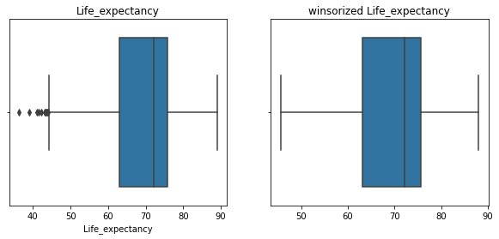
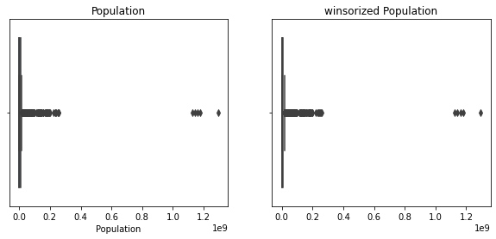
Data Wrangling
Outliers visualization and treatment
Winsorize method to treat Outliers
Dataset has 2938 observations and 22 columns (21 are independent variables)
Predicting variables were then divided into several broad categories:​Immunization related factors, Mortality factors, Economical factors, and Social factors.
Box plot before and after winsorize application (0.01, 002)
Notes:
symmetric process that replaces the k smallest and the k largest data values

Slide 5
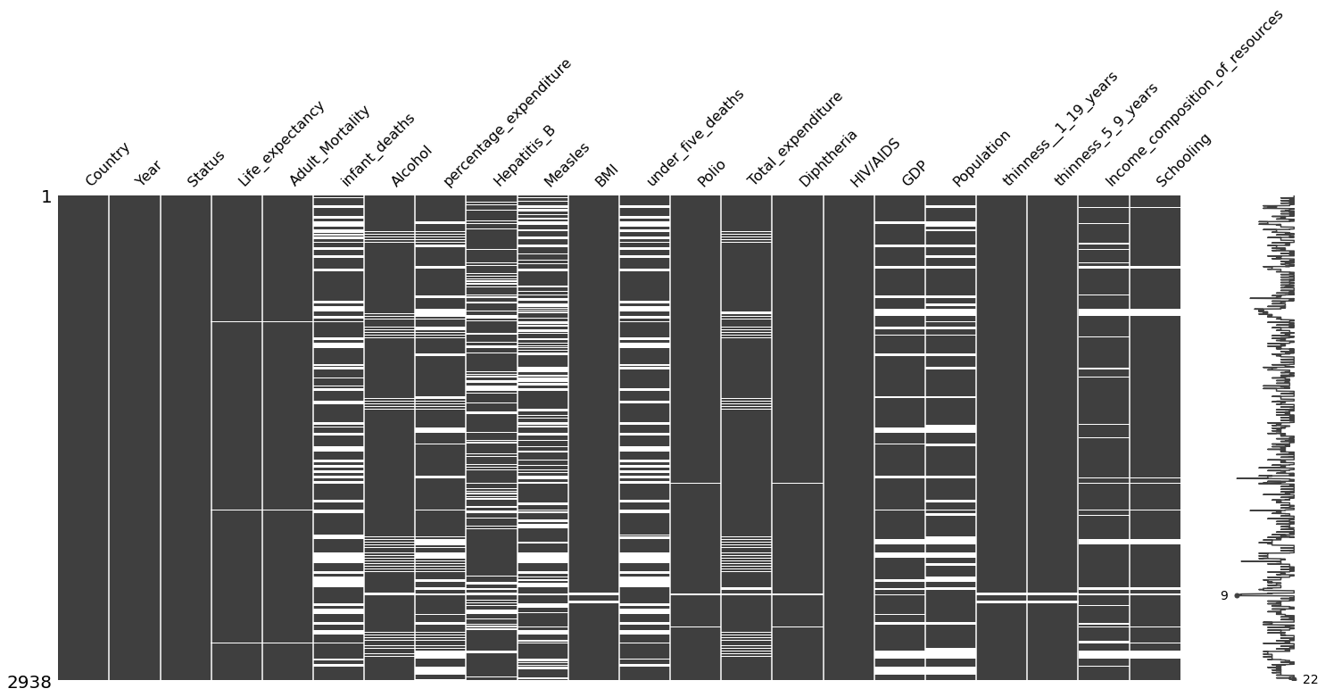
Data Wrangling
Assessing and treating Missing Value

Slide 6
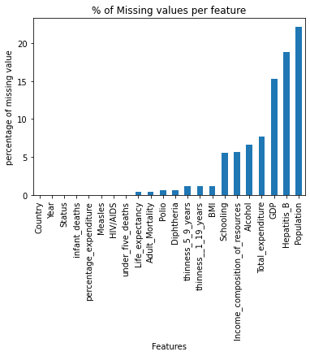
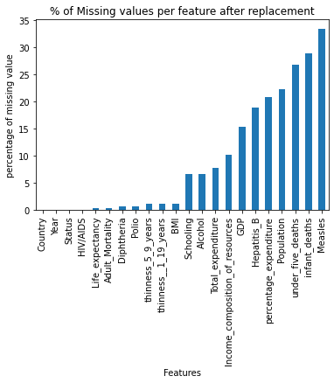
Data Wrangling
Assessing and treating Missing Value
Original state of data with missing value and after the replacement of the uncommon type with NAN
Notes:
14 columns with missing values, where the population has 22% of missing values, followed by Hepatitis_B with 19% and GDP with 15%. The others 11 columns were between 7% and 1%.
(19 columns) as well as the total number of missing values.

Slide 7
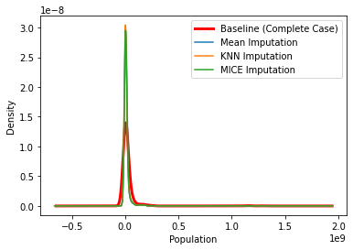
Data Wrangling
Assessing and treating Missing Value
The best imputation technique is: MICE Imputation
Notes:
Mean, mode, constant and median imputation with SimpleImputer from sklearn,
and KNN imputation and , MICE imputation using fancyimpute.
The evaluation of the imputation method was done with the simple linear regression, the Ordinary Least Squares (OLS) of stats models. The result showed that mice imputation was the best one. In fact, mice algorithm performs multiple regressions for imputing

Slide 8
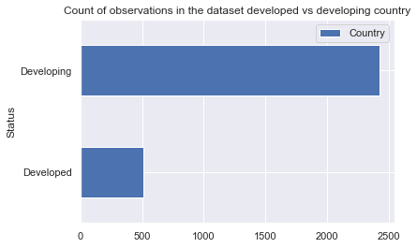
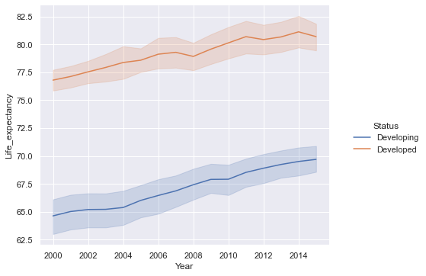
Exploratory Data Analysis
What is the trend of life expectancy?
151 developing countries account for 2426 and
32 developed countries for 512 Observations
Notes:
no duplicate found in the dataset.
There are 193 countries, where 32 are developed countries (DDC) and 151 are developing countries (DPC).
the general trend showed that live expectancy have increase from 2000 to 2014

Slide 9
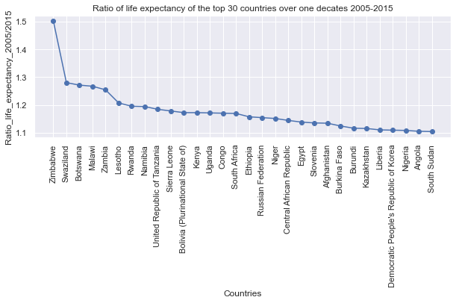
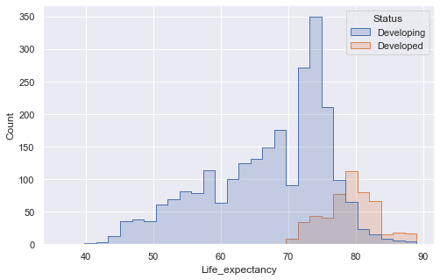
Exploratory Data Analysis
How was the life expectancy over one decade (2005 to 2015) ?
How does the distribution of life expectancy look like?
Min in developed countries is 69 /developing countries is 39.
Maxi in developed countries is 89 , the same in developing countries.
Notes:
The range of life expectancy is huge in developing countries as compared to developed countries.
Except Switzerland ( 2nd position) Slovenia (20th position), we found that almost all of the countries (the top 30) which high ratio of life expectancy over a decade of 2005 to 2015 are from developing countries.

Slide 10
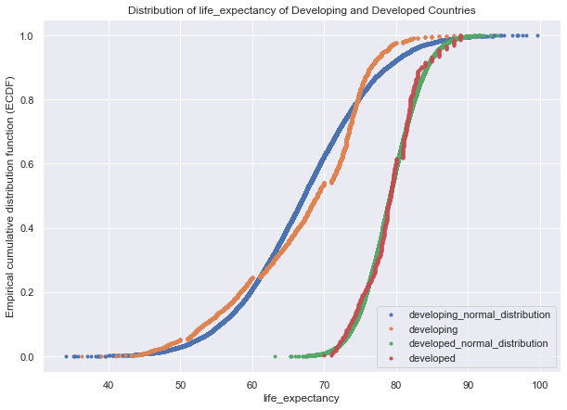
Exploratory Data Analysis
Statistical Analysis
p = 3.4988e-34
The null hypothesis can be rejected
Confidence Interval of Life expectancy at 95%
*CI developing countries : [64.834, 68.364]
*CI developed countries : [77.911, 79.451]

Slide 11
Exploratory Data Analysis
Statistical Analysis
1- state the hypothesis
Null Hypothesis: the average mean of life expectancy from developed countries is always greater than the one of developing Countries
ho: mean avg of LE _developed = mean avg of LE _developing
h1: mean avg of LE _developed != mean avg of LE _developing
2- state the significance level (here we set the threshold for the test)
alpha = 0.05 or 5% z= 1.96 for one tail, and z= 1,64 for two tail
3- identify the test statistic
we conduct a Z test for 2 independants samples,
4- Conclusion:
From This result, we reject the null hypothesis, we found that there is a significant difference between the mean average life expectancy of developed countries to that of developing countries.

Slide 12
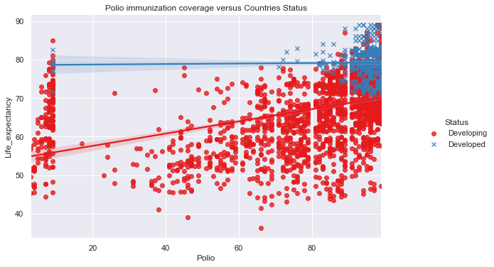
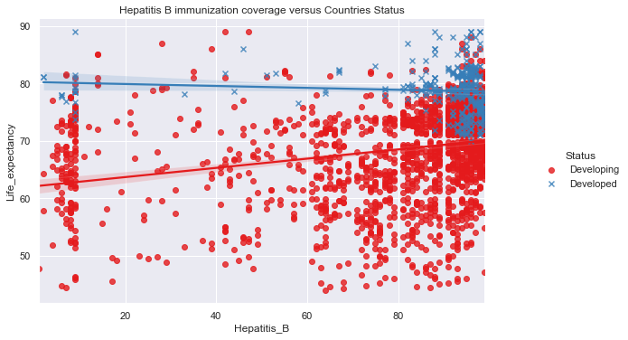
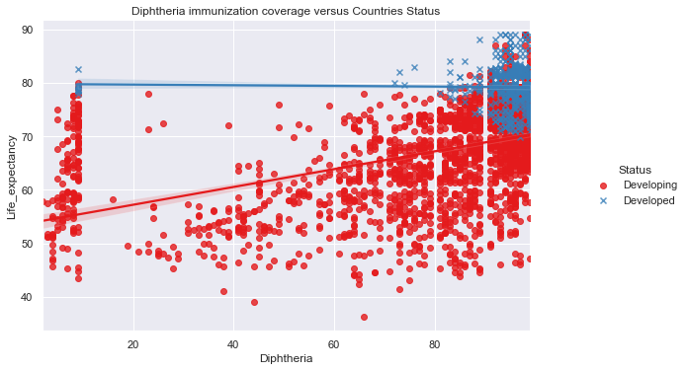
Exploratory Data Analysis
Immunization and life expectancy
Notes:
Immunization factors has a positive impact on increasing life expectancy in developing countries as compared to developed countries where the impact is not important.

Slide 13
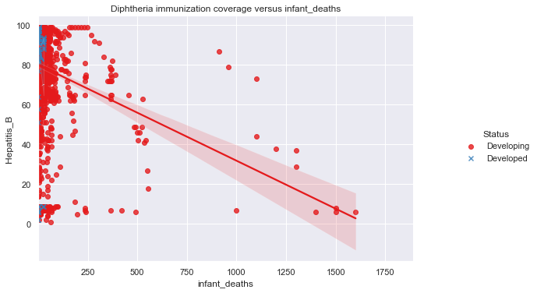
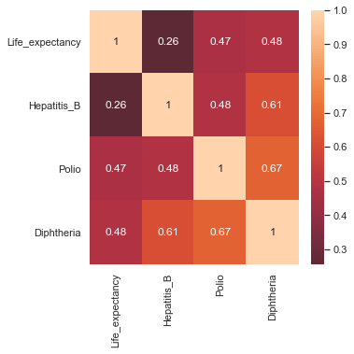
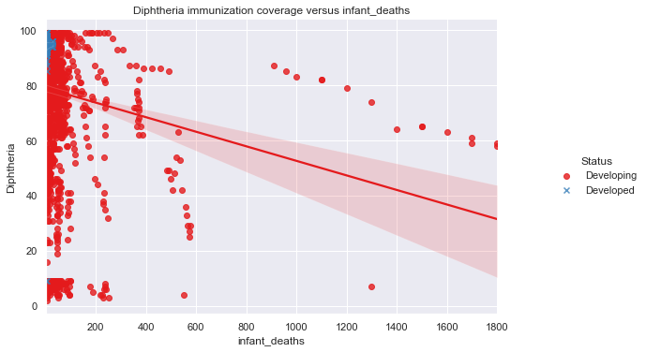
Exploratory Data Analysis
Immunization and life expectancy , and mortality factors
Notes:
we observed that immunization features are related to mortality features such as infant deaths, under five-year-old deaths, and adult deaths. The mortality decreases with the increase of immunization

Slide 14
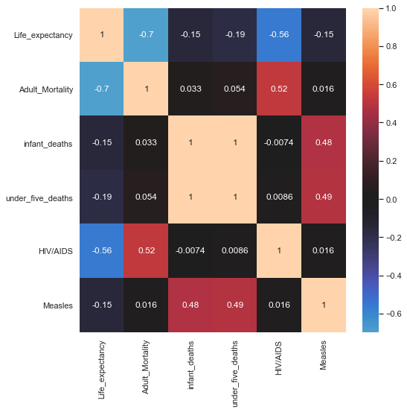
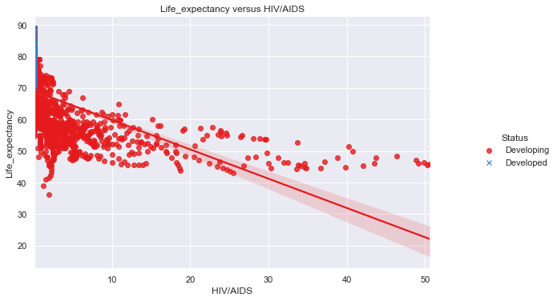
Exploratory Data Analysis
Mortality_factors and Life_expectancy
Notes:
mortality factors are all negatively correlated with life expectancy

Slide 15
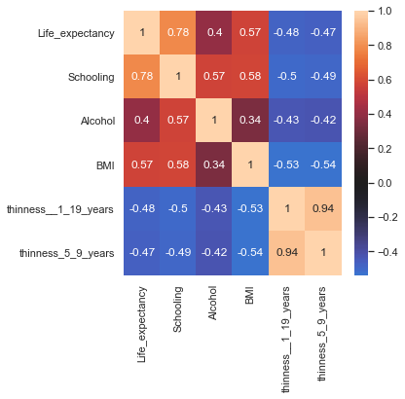
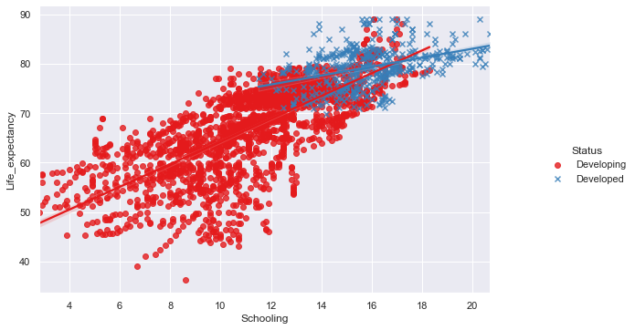
Exploratory Data Analysis
Social Factors and life_expectancy
Notes:
schooling has the highest positive correlation score of 0.78 with life expectancy; it is followed by BMI and Alcohol.

Slide 16
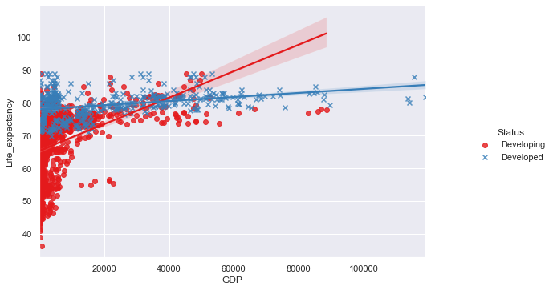
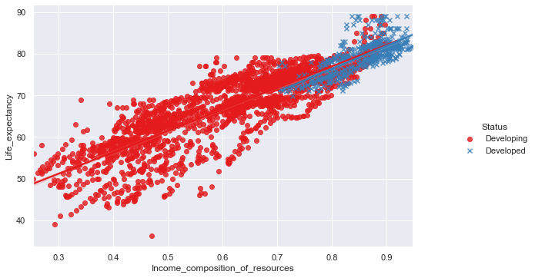
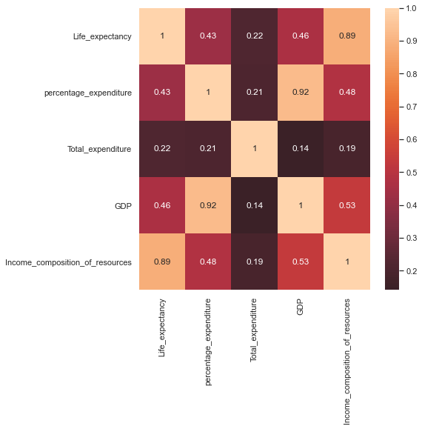
Exploratory Data Analysis
Economical_factors and Life_expectancy
Notes:
All the economic factors have positive correlation with life expectancy. The highest factor is income composition of resources followed by GDP and percentage expenditure

Slide 17
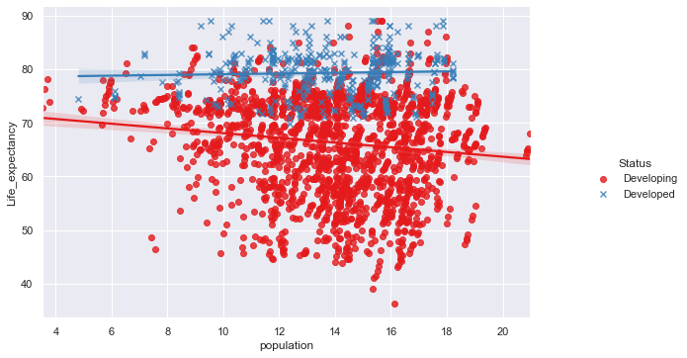
Exploratory Data Analysis
Population and life expectancy
Notes:
the increase of population in developing countries impact negatively the level of life expectancy. This is not the case in developed countries where we observe a slightly increase in life expectancy with the increase of population.
This observation could be explained with the level of economic factors in both countries such as GDP and income composition of resources (figures xx and xxx) which are lower in developing country as compared to developed countries. In fact economic factors have a great power in implementation of heath politic.

Slide 18
Preprocessing the data
Label Encoder of categerical variable with one hot_encoder
Imputing missing value (Mice imputation)
Divide in test set and train set (30% , 70%)
Scaling the dataset
PCA transformation

Slide 19
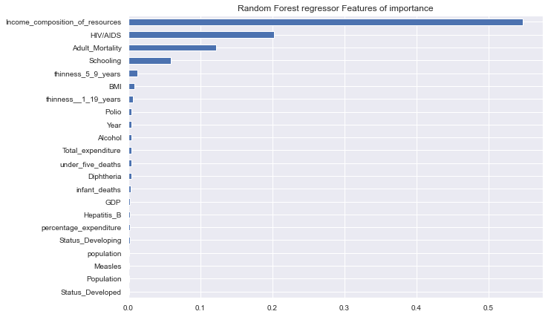
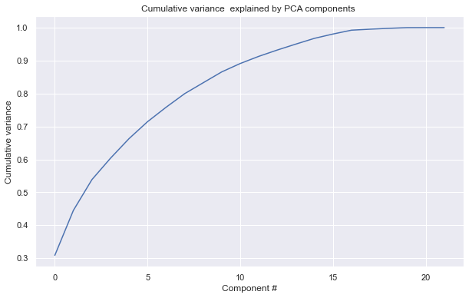
Preprocessing the data
Note: The first five components seem to account for over 75% of the variance, and 10 components is 92% of the variance

Slide 20
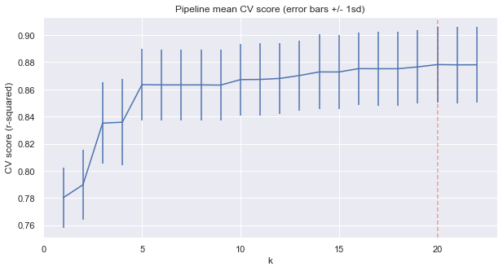
Modelling
pipe = make_pipeline(
IterativeImputer(),
StandardScaler(),
SelectKBest(f_regression),
LinearRegression()
{'selectkbest__k': 20}
The above suggests a good value for k is 20

Slide 21
Modeling
model | model_definition
random_forest_reg1 | RandomForestRegressor(max_depth=4, max_features=0.4, n_estimators=200, n_jobs=-1, random_state=1)
random_forest_reg2 | RandomForestRegressor(max_depth=10, max_features=0.4, n_estimators=200, n_jobs=-1, random_state=1)
random_forest_reg3 | RandomForestRegressor(max_depth=7, max_features=0.3, n_jobs=-1, random_state=1)
random_forest_reg4 | RandomForestRegressor(max_depth=8, max_features=0.6, n_estimators=200, random_state=1)
gradien_boost_1 | GradientBoostingRegressor(n_estimators=150, random_state=1)
gradien_boost_2 | GradientBoostingRegressor(learning_rate=0.08249999999999999, max_depth=10, max_features=0.6000000000000001, min_samples_leaf=8, min_samples_split=10, n_estimators=118)
gradien_boost_3 | GradientBoostingRegressor(learning_rate=0.08249999999999999, max_depth=7, max_features=0.8, min_samples_leaf=4, min_samples_split=12, n_estimators=150, random_state=1)
XGBRegressor | XGBRegressor(base_score=0.5, booster='gbtree', colsample_bylevel=1, colsample_bynode=1, colsample_bytree=1, enable_categorical=False, gamma=0, gpu_id=-1, importance_type=None, interaction_constraints='', learning_rate=0.04, max_delta_step=0, max_depth=5, min_child_weight=1, missing=nan, monotone_constraints='()', n_estimators=200, n_jobs=-1, num_parallel_tree=1, predictor='auto', random_state=0, reg_alpha=0, reg_lambda=1, scale_pos_weight=1, subsample=1, tree_method='exact', validate_parameters=1, verbosity=None)
voting | VotingRegressor(estimators=[('gb', GradientBoostingRegressor(random_state=47)), ('rf', RandomForestRegressor(random_state=47)), ('lr', LinearRegression())])
model | model_definition
linear_reg | Pipeline(steps=[('iterativeimputer', IterativeImputer()), ('standardscaler', StandardScaler()), ('selectkbest', SelectKBest(k=19, score_func=<function f_regression at 0x0000025E60390C10>)), ('linearregression', LinearRegression())])
linear_reg2 | Pipeline(steps=[('iterativeimputer', IterativeImputer()), ('standardscaler', StandardScaler()), ('pca', PCA(n_components=19)), ('linearregression', LinearRegression())])
ridge_reg | Pipeline(steps=[('iterativeimputer', IterativeImputer()), ('standardscaler', StandardScaler()), ('ridge', Ridge(alpha=0.5))])
Elastic_net | ElasticNet(alpha=0.0001, l1_ratio=0.4)
decision_tree | DecisionTreeRegressor(max_depth=4, max_features=0.2, min_samples_leaf=0.1, random_state=1)
Notes:
A bunch of models has been developed:
Regression model: simple Linear regression, linear regression with principal component analysis (PCA), ridge regression, Elastic net regression,
Tree base model: Decision tree,
Tree base model - Ensemble model: random forest, Gradient Boosting , XGBoost and voting.

Slide 22
Modeling
R square score in train set and test set
model | R2_tr | R2_tt
gradien_boost_2 | 0.999 | 0.950
gradien_boost_3 | 0.997 | 0.947
random_forest_reg2 | 0.986 | 0.945
random_forest_reg4 | 0.976 | 0.942
XGBRegressor | 0.982 | 0.941
random_forest_reg3 | 0.962 | 0.931
voting | 0.965 | 0.930
gradien_boost_1 | 0.970 | 0.929
random_forest_reg1 | 0.919 | 0.900
linear_reg2 | 0.882 | 0.868
linear_reg | 0.882 | 0.868
ridge_reg | 0.882 | 0.868
Elastic_net | 0.882 | 0.863
decision_tree | 0.743 | 0.682
Notes:
Models have been evaluated on test and train dataset. Mean absolute error (MAE), Mean squared error (MSE), Root Mean Squared Error (RMSE) and R-squared (R2) are metrics that were used to evaluate the performance of the models developed.
MAE is a metric that summarizes the difference between the predicted and the actual values. It is the mean of absolute error values. It is very robust to outliers (in contrary to MSE and R2). In fact, if one wants to ignore the outlier values to a certain degree, MAE is the choice since it reduces the penalty of the outliers significantly with the removal of the square terms.
MSE is an absolute measure of the goodness of lit. It is very sensitive to outliers and will show a very high error value even if a few outliers are present.
RMSE is the root of MSE and is beneficial because it helps to bring down the scale of the errors closer to the actual values, making it more interpretable.
R-squared helps to identify the proportion of variance of the target variable that can be captured with the help of the independent variables or predictors. R2 increases with any new feature addition. If there are too many independent variables, the model can overfit, performing well on train data and will perform poorly on test data.

Slide 23
Conclusion
Life expectancy has increased over years in both developed and developing countries
The mean average of the life expectancy of developed countries is generally higher compared to that of developing countries
However, the ratio of LE over the decade of 2005 to 2015 showed that life expectancy in developing countries has greatly increased.
It has been highlighted that immunization has impacted the improvement of life expectancy in a developing country, as well as the reduction in infant deaths.
The analysis revealed that economic factors play an important role in the system, it is why countries with higher income resources and GDP tend to have high life expectancy even if the population is big. In developing countries, an increase in the population tends to impact negatively life expectancy.
Many (14) regression models have been developed to predict expectancy, the chosen one is Gradient boost with MAE of 0.202 on train set and 1.431 on the test set, R square is 0.94 on the test set.

